Slide 1
DELTA KAPPA EPSILON
Delta Psi Chapter | Alumni Newsletter
AUGUST 2023

Slide 2
Table of Contents
TITLE
PAGE
A Letter from Brother Beta
3.
About the Reestablished Delta Psi Chapter
5.
Introduction to the Executive Team
8.
Executive Goals, Plans, and Accomplishments
11.
Sample Chapter Statistics
13.
Delta Psi Alumni | Chapter Involvement
15.
A Letter from Brother Sigma
17.
Appendix, Old and New Chapter Media
19.

Slide 3
Section I. A Letter from Brother Beta

Slide 4
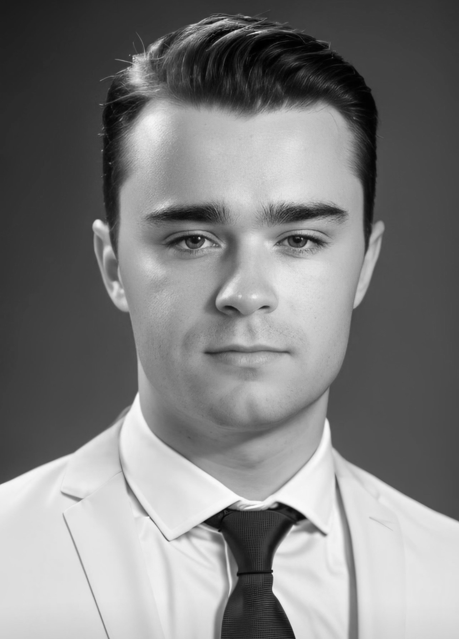

Brother Beta’s First Letter to the Alumni
Greetings from the Delta Psi Chapter!
As we set forth on this remarkable journey, I am brimming with pride and profound appreciation for the solid foundation you all have helped lay. Our chapter's inception began humbly, as a group of three friends bound by a shared vision. Today, our ranks have swelled to 30 members, a testament to the tireless dedication of our executive board in rebuilding Delta Psi from the ground up, coupled with our resolute recruitment efforts.
The strides we've taken owe their fruition to the unwavering support we've received from both the national team and our valued alumni. While our progress thus far is a source of pride, we remain poised to extend our reach even further. Our aspirations for this semester include a robust 50% expansion of our membership base, along with plans to host a plethora of engaging brotherhood events. We are committed to continuing the cultivation of a long-lasting infrastructure within our newly revitalized chapter, catalyzed by a constant desire to innovate and evolve.
The Delta Psi chapter is deeply grateful to our alumni whose guidance and support have been instrumental. We stand united in our resolve to not only preserve the legacy you have helped create but to carry it forward, embracing the challenges and triumphs that lie ahead.
In the Bonds,
Augustus “Gus” Pelis | Brother Beta, Delta Psi
About Brother Beta
Hailing from Newton, Massachusetts, Gus Pelis is a junior studying informatics and business at Indiana University. Intrigued by IU's strong school spirit and the potential to make a profound impact on a Big 10 campus, Gus chose IU for these unique opportunities. With a vision to revitalize the Delta Psi Chapter, he aims to establish a lasting legacy within the Greek community, combining academic excellence and an unwavering commitment to create a vibrant presence at IU.
Please feel free to contact Brother Beta at Gpelis@iu.edu.

Slide 5
Section II. About the Reestablished Delta Psi Chapter

Slide 6
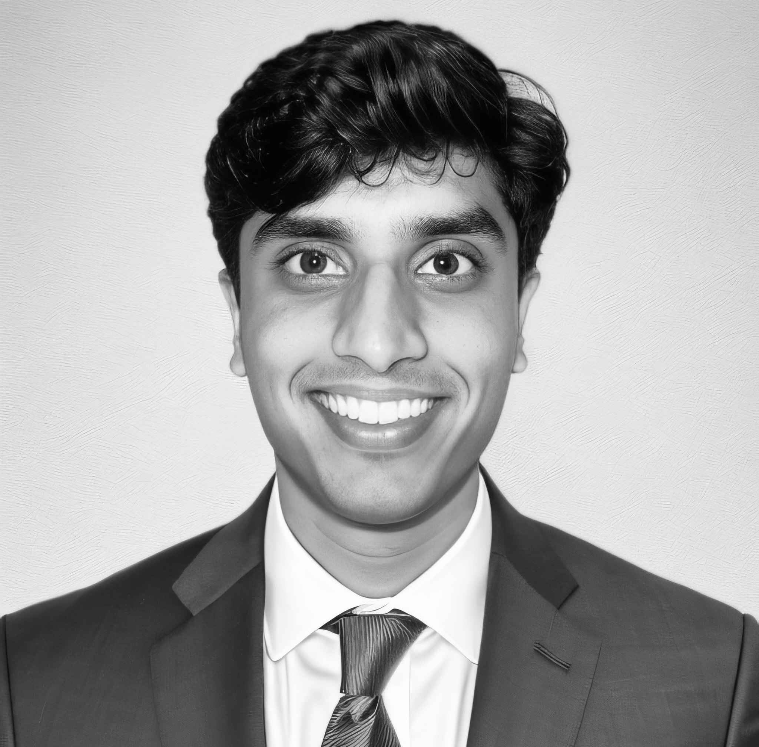
Delta Psi Associate Chapter Overview A Brief History of Our Journey Thus Far
Oct-’22
3 IU Students Contact DKE Nationals
Oct-’22
Official Interest Group is formed
Introducing Our Alumni Relations Chair
Coming from Dallas, Texas, Srinath Rao, the Delta Psi Alumni Relations Chairman is ecstatic to present our chapters first newsletter.
Firstly, Sri would like to reiterate Brother Beta’s gratitude to our esteemed alumni – the outpouring of support we have received has instilled in us a great confidence that together we can make Delta Psi great again.
We hope you enjoy this newsletter, and please feel free to get in touch with Sri at raosr@iu.edu, or (214) 945-5909. Thank you!
Dec-’22
Interest Group Achieves Milestone of 15 Members
Feb-’22
Interest Group Learns of Possible Fall ‘23 Expansion
Apr-’23
Interest Group Presents to IU for Possible Expansion
May-’23
Interest Group Gains 30 Members
Jun-’23
Interest Group Gains Associate Chapter Status
Jul-’23
Full Executive Board is Formed
Looking Forward…
Aug-’23
Multiple initiatives underway for semester launch
Sep-’23
Associate Chapter Launches Website
Oct-’23
Alumni Advisor found and Alumni Board Formed
Nov-’23
First Alumni Tailgate Hosted Alongside Brotherhood Events
Jan-’24
Associate Chapter Breaks 40+ Brothers
Feb-’24
Associate Chapter Petitions for Ful Chartering

Slide 7





Delta Psi Associate Chapter Overview A Culture of Academic Excellence
Delta Psi Brothers Are Leaders Across all Fields of Study
What the Delta Psi Brothers are Pursuing:
The Delta Psi Impact on our Community:
Business
Financial Services & Investment Banking
Corporate Innovation
Marketing
Strategy Consulting
1
2
Academic Excellence
Multiple brothers in the Investment Banking Workshop and leadership positions across various student organizations
Entrepreneurship
Multiple brothers with successful businesses/startups across a variety of fields
Quantum Computing
Computer Science & Machine Learning
Aerospace Physics
Informatics
Cybersecurity
S.T.E.M.
Philanthropy
Brother-founded charity Mission Magnet to help veterans overcome PTSD, which has successfully raised funds for the cause
Scholarship
Several members with scholarships and accolades from IU including Cox Scholarship and Hutton Honors Scholarship
Arts
Economics
Biochemistry
Marine Biology
Media
3
4
Delta Psi by the Numbers
36% of Brothers Hold Leadership Positions
71% Of Brothers Have Internships
3.49 Mean GPA
~90% Of Brothers Play Sports
Update once survey results are in.
Additionally, Delta Psi represents over four countries and every region of the U.S., exemplifying the vast culture in our chapter

Slide 8
Section III. Introduction to the Executive Team

Slide 9
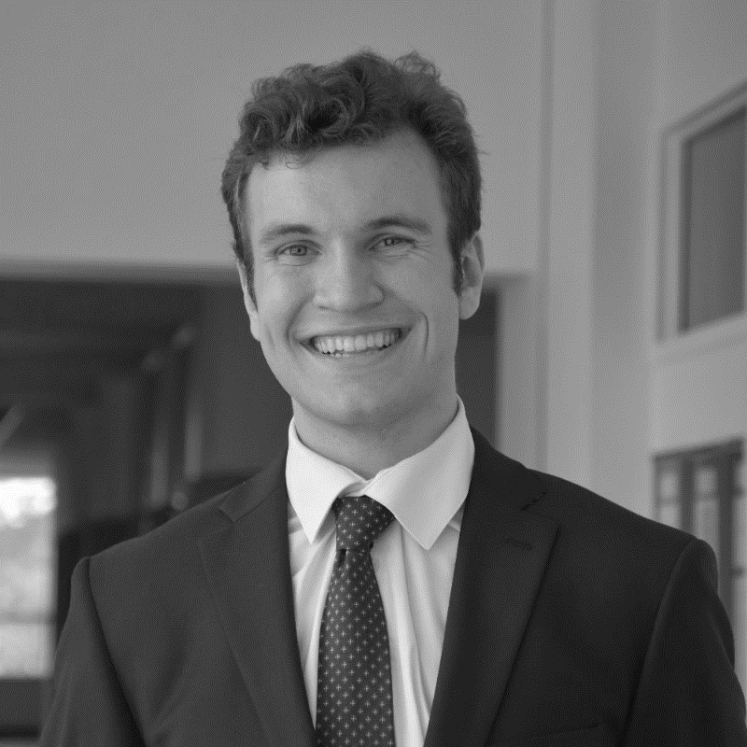
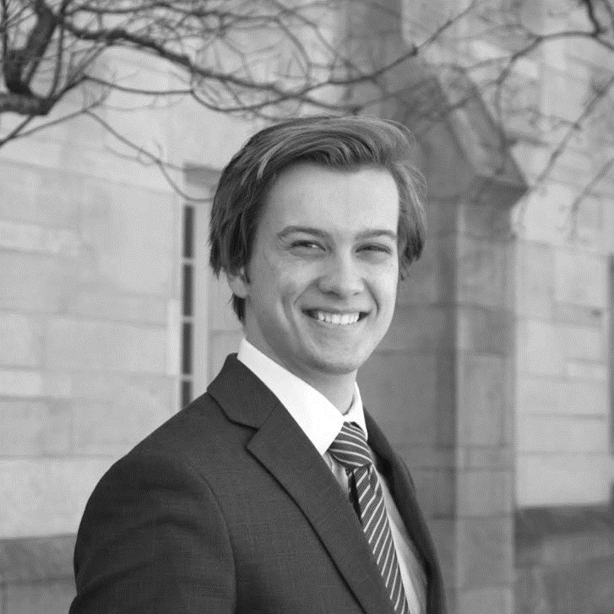
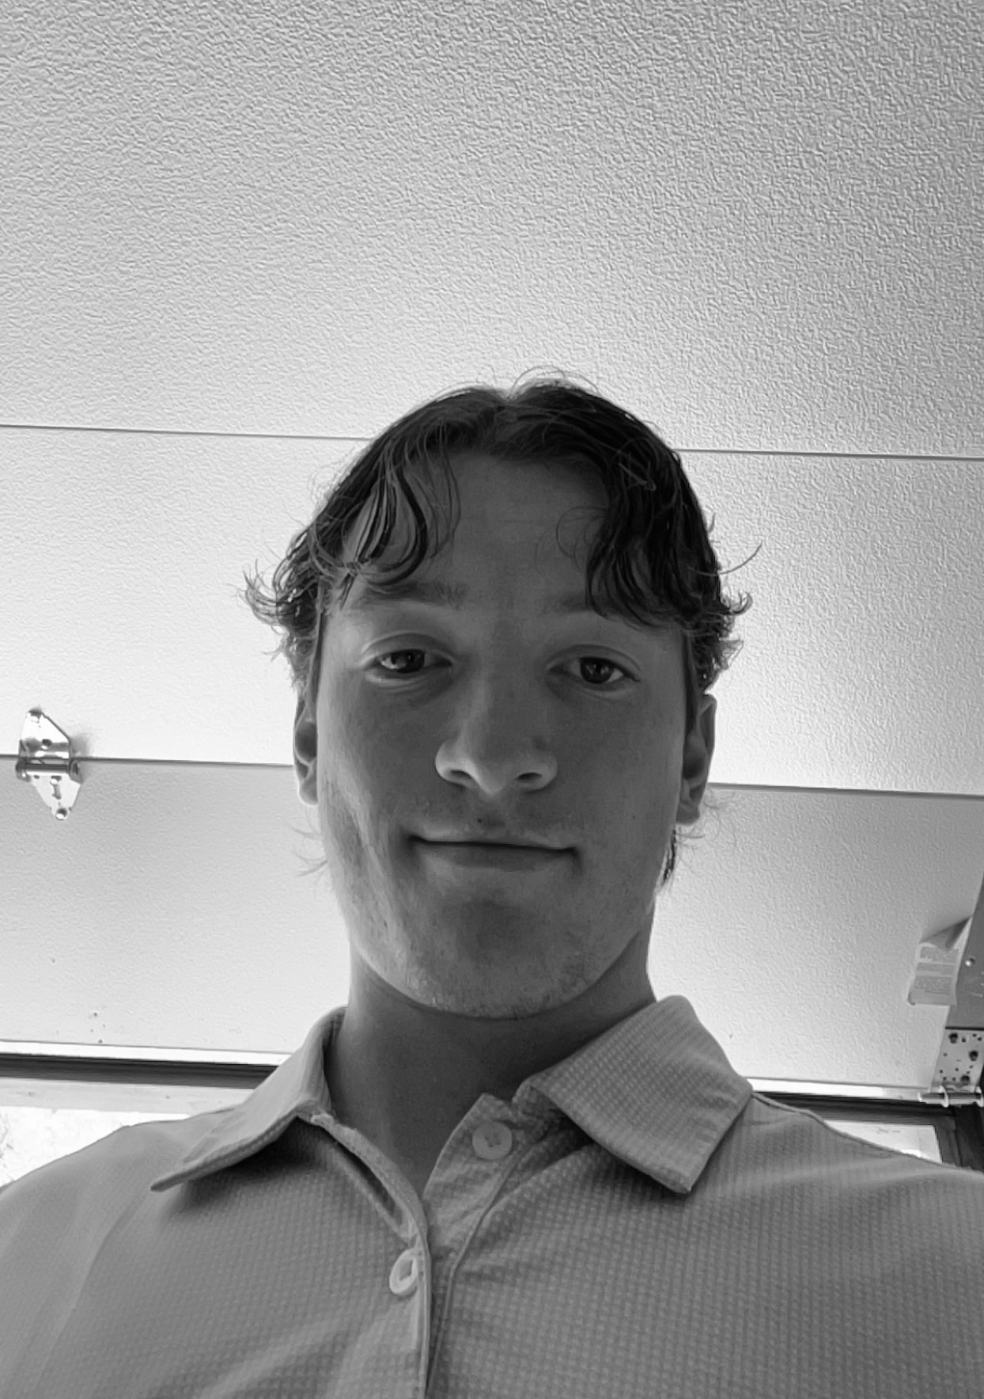
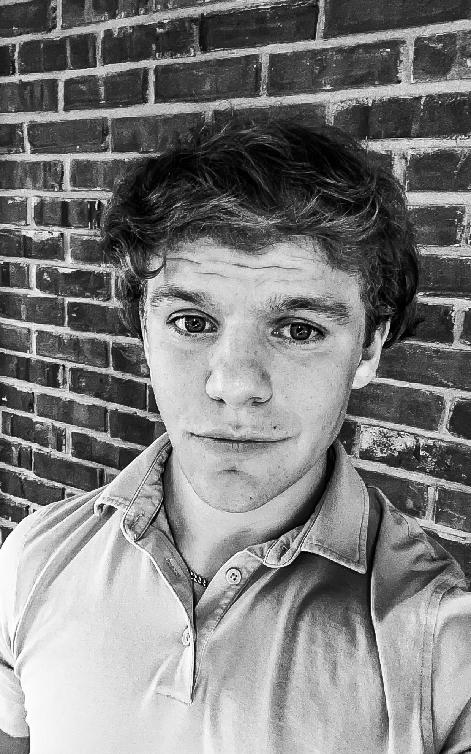
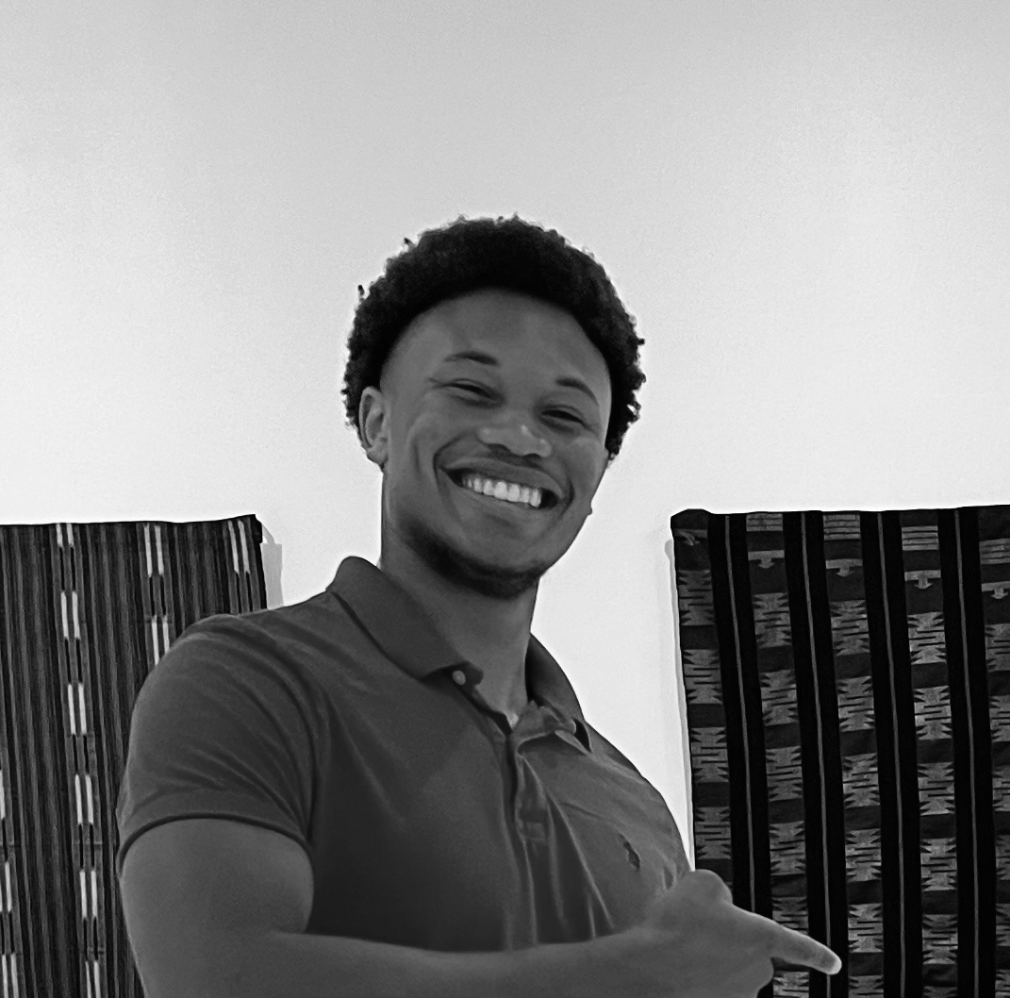
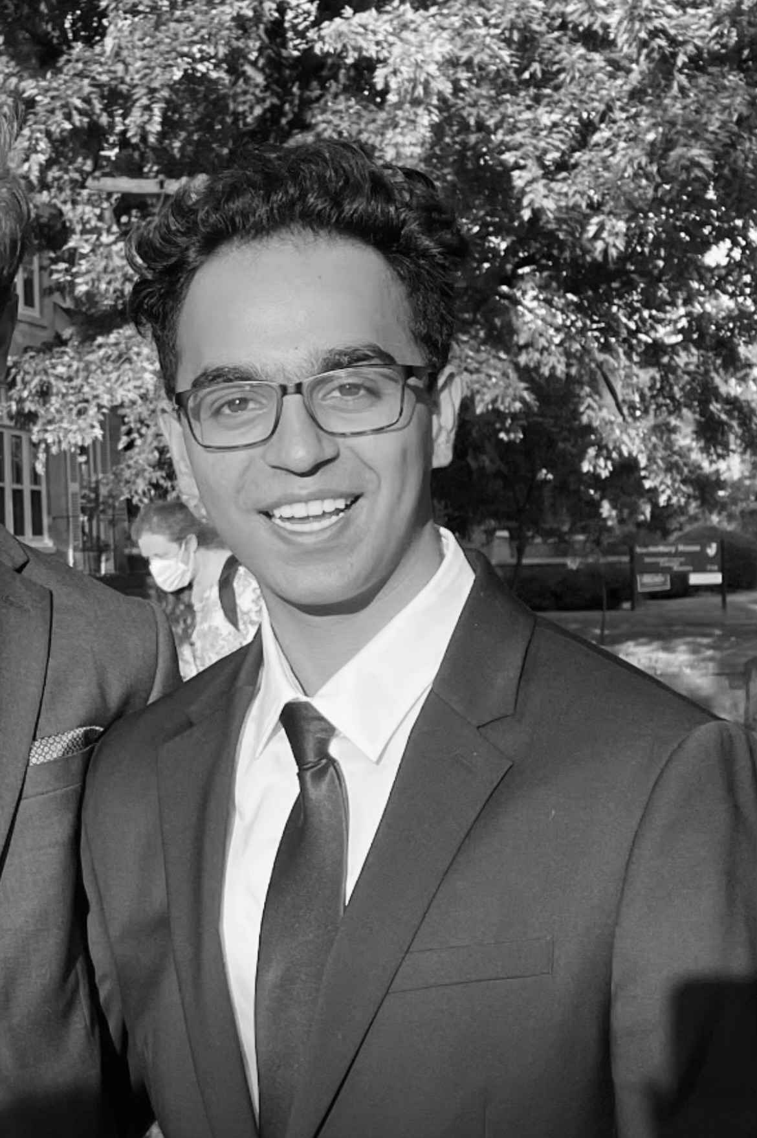
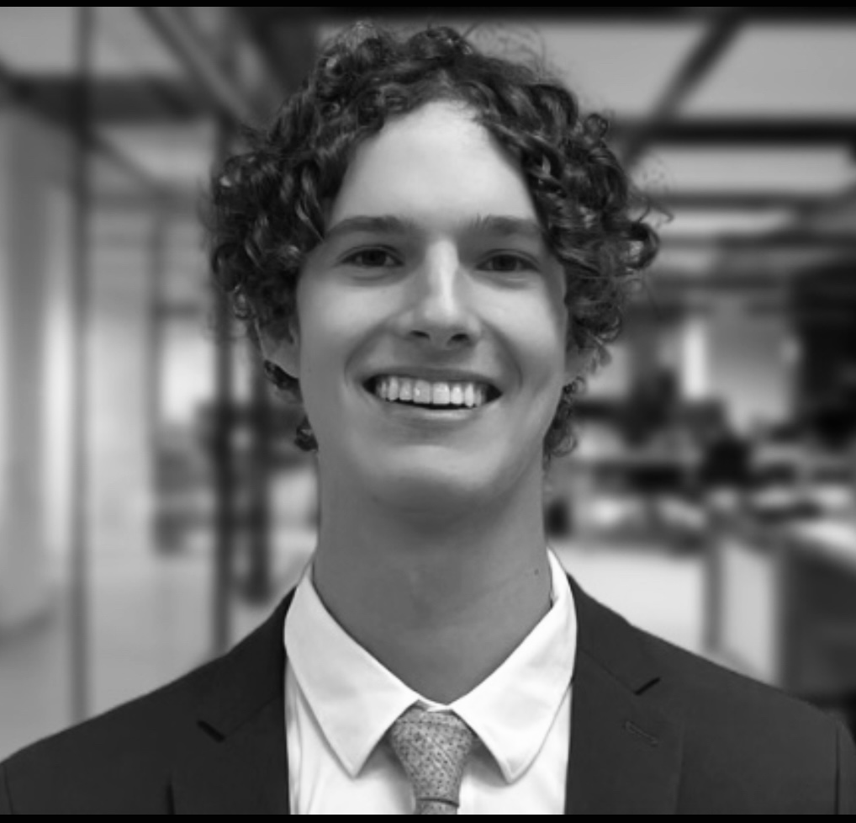
Delta Psi Associate Chapter Introduction to the Executive Team
Gus Pelis
President
Lukas Daub
Vice President
Micah Roberson
Brotherhood Chair
Srinath Rao
Alumni Relations Chair
Owen Urtel
Co-Chair, Public Relations
Garrett Katterhenry
Co-Chair, Public Relations
Dalijah Marks
Recruitment Chair
Aryan Sanan
Vice President of Health & Safety
Thomas Zeedyk
Treasurer

Slide 10
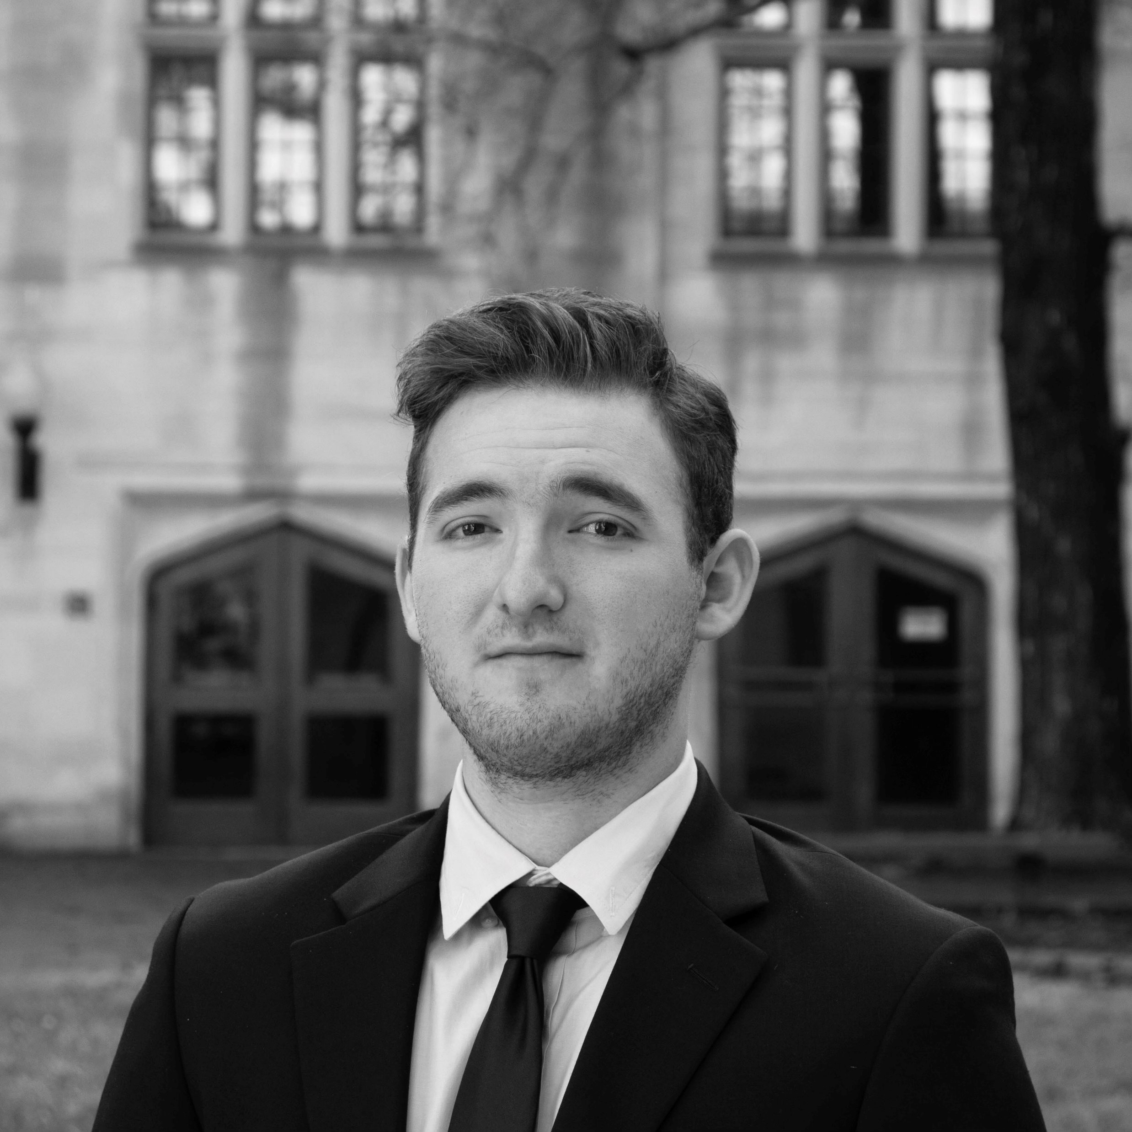
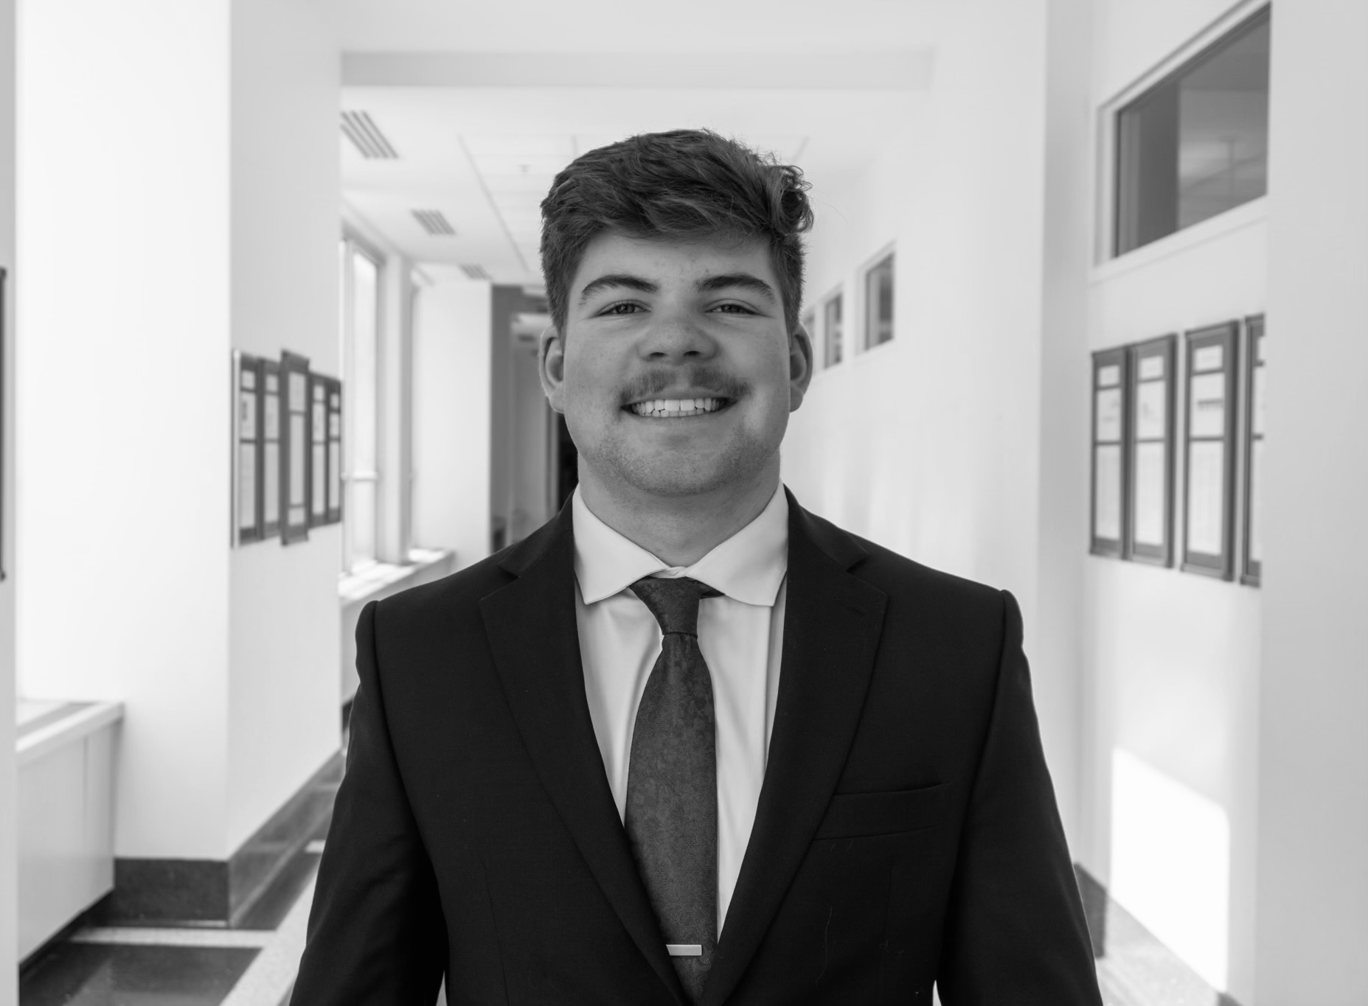

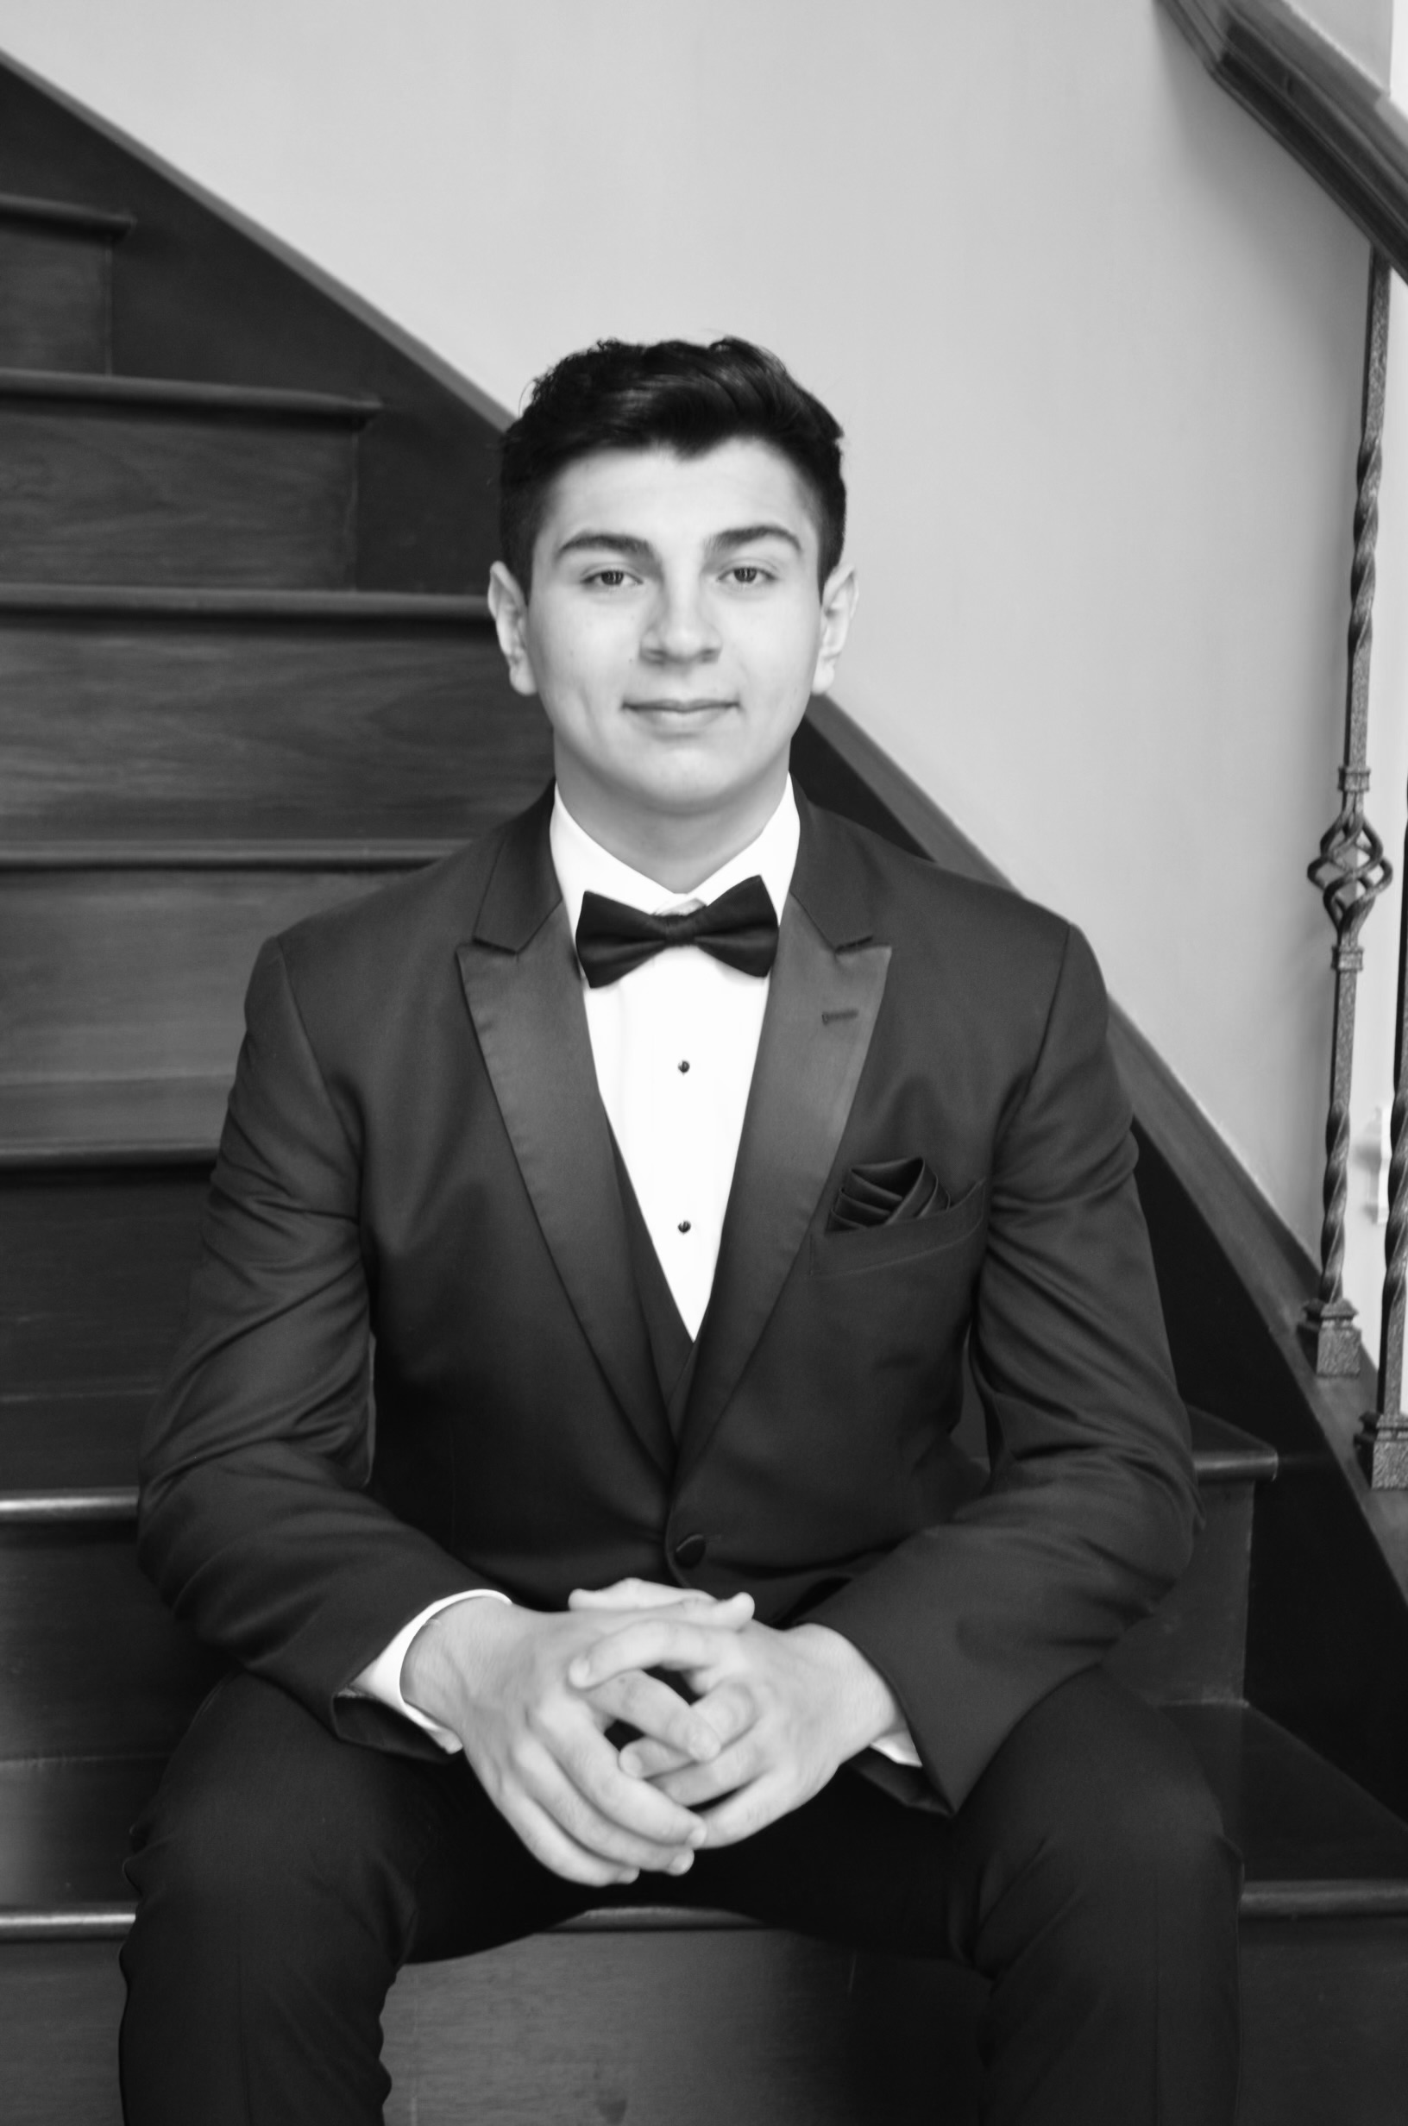
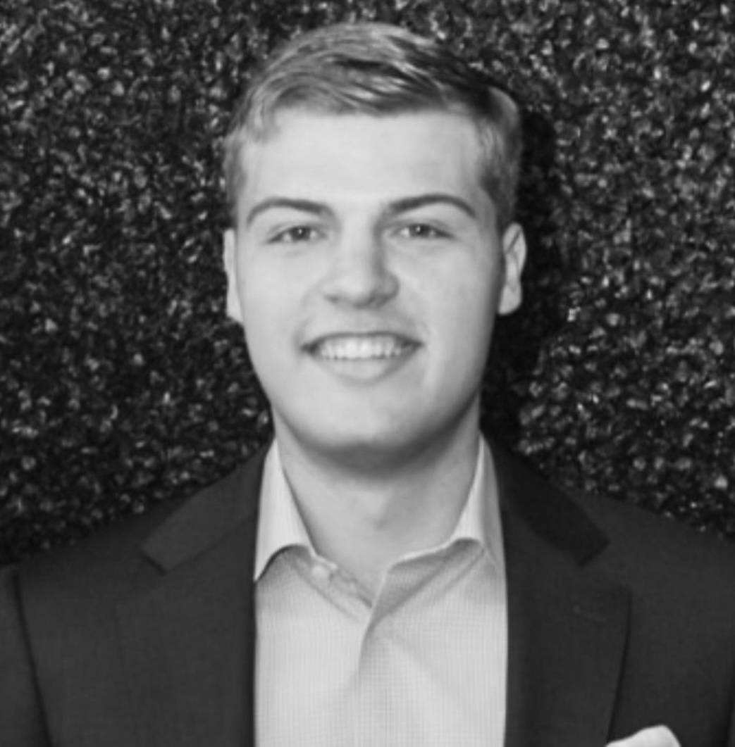
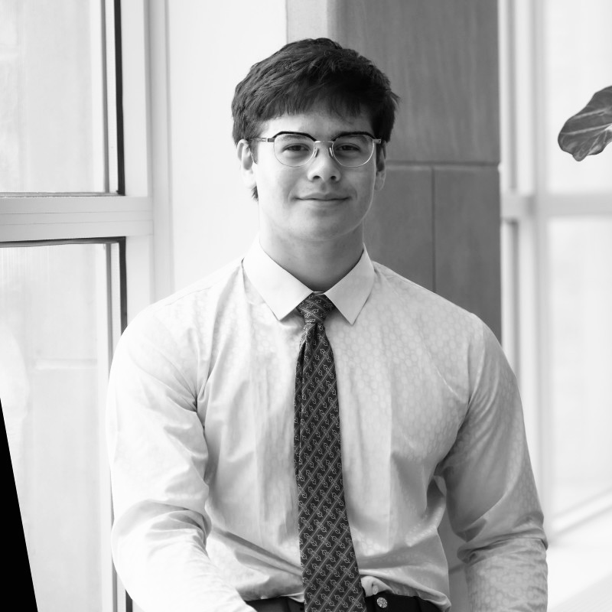
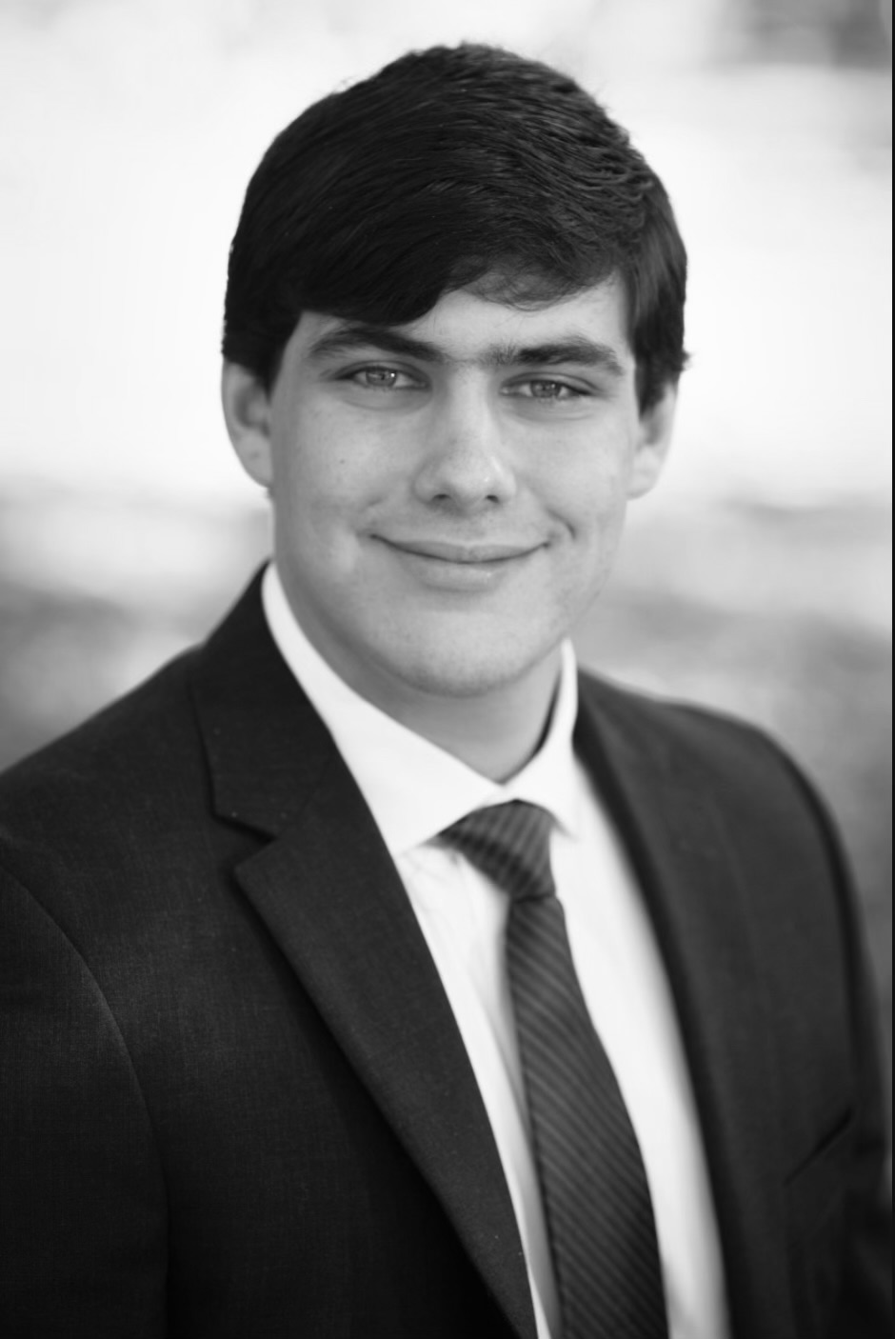
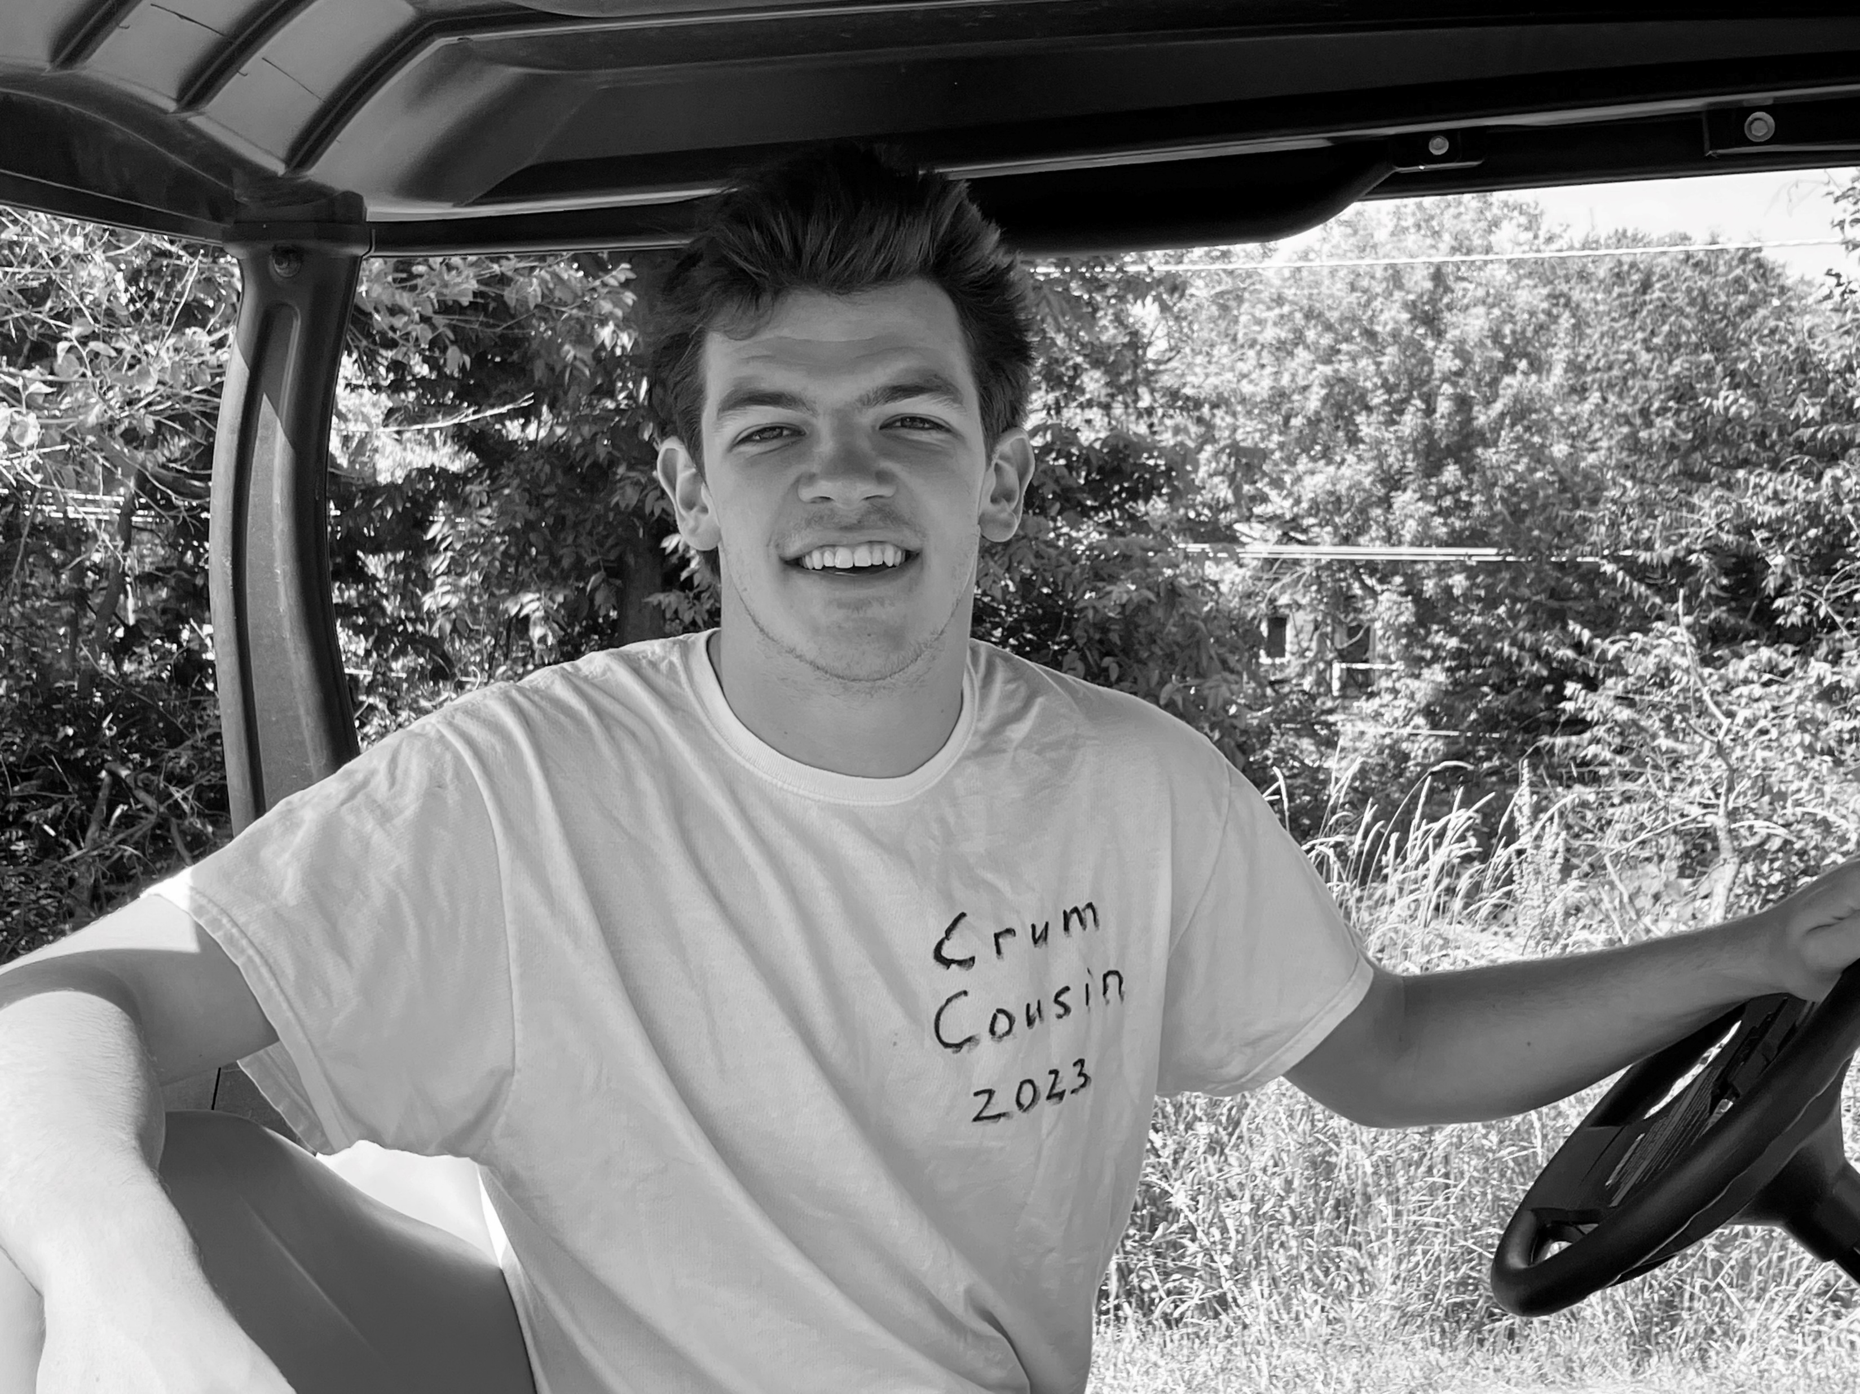
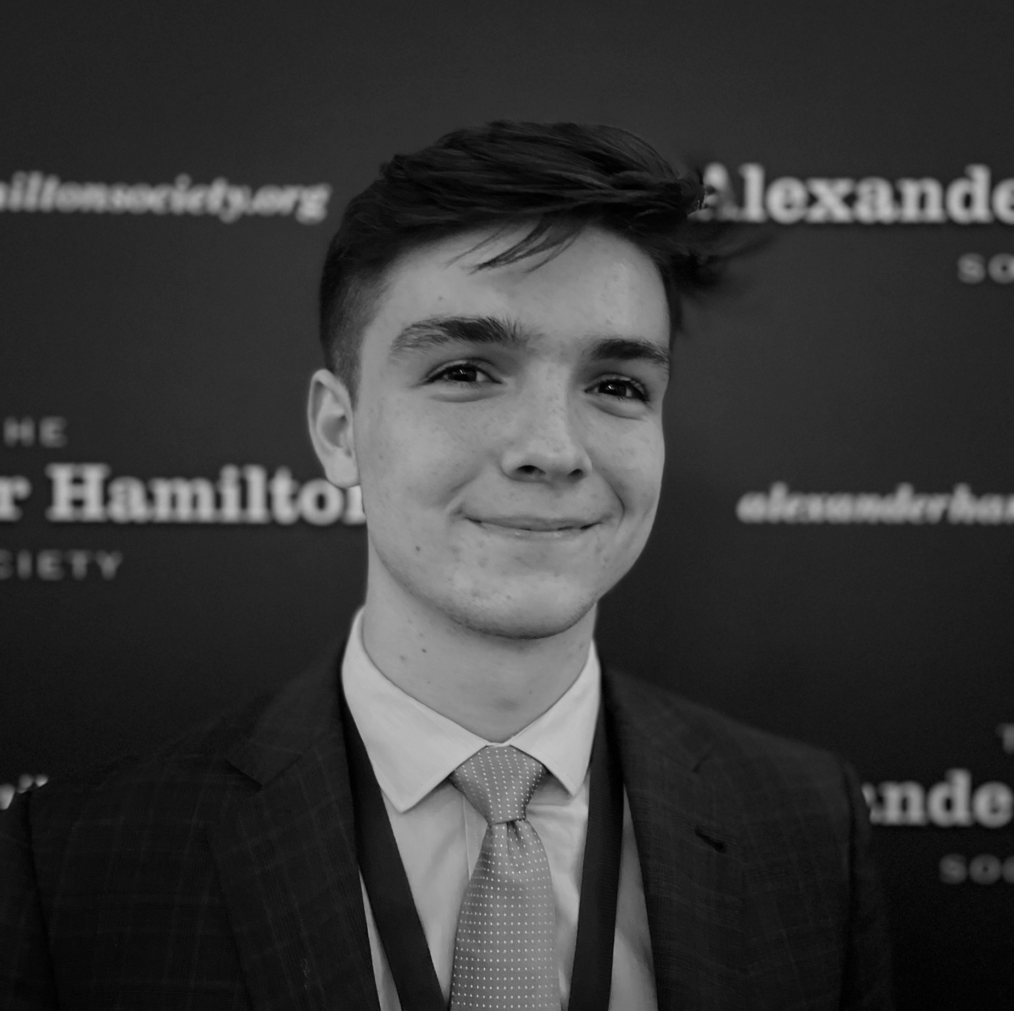
Delta Psi Associate Chapter Introduction to the Executive Team
Matt Walker
Corresponding Secretary
Zack Pankau
Recording Secretary
Eric Howell
Social Chair
Antonio Bruno
DEI&A Chair
Austin Sigman
Philanthropy Chair
Jake Heimowitz
Sergeant-at-Arms
Logan Mogil
Historian
Dillon Holland
Master of Ceremonies
Will Sinciline
IFC Representative

Slide 11
Section IV. Executive Goals, Plans, and Accomplishments

Slide 12



Delta Psi Executive Board Fall 2023 Key Goals and Plans
Spearheading Vital Initiatives to Support Chapter Growth
Ensuring Chapter Longevity Through the Creation of Critical Infrastructure
Creation and launch of Delta Psi Website to help all future brothers
Cultivation of key processes, such as recruiting and bidding process
Creation of Delta Psi Mission, Vision and Values to ensure alignment with goals
Promoting Involvement and Strengthening Brotherhood Bonds
Nashville Country Music Festival to be planned for a DKE retreat
End-of-Semester formal to cultivate stronger brother relationships
Establishment of recruitment, brotherhood and social committees to
ensure every Brother is invested in the growth of the Chapter
Connecting Brothers with Potential New Members and Creating a Brand Image
“Letters Day”, an initiative where all brothers wear letters on campus once a week
“DKE Tailgates”, with a DKE tent, gaining awareness and connecting with PNMs
Delta Psi Key Goals Across Brotherhood, Recruitment and Social Activities
Brotherhood
Recruitment
Social
Plan and attend end of semester formal, as a way to reward brothers for hard work all semester and strengthen bonds
Host at minimum one brotherhood event a week, to constantly interact with brothers (E.g., paintball, country festival, etc.).
Ensure Brotherhood events are inclusive of all backgrounds and culture
Recruitment 10+ members to ensure Chapter is on track for 2024 chartering
Involve every brother with the recruitment process, to ensure DKE is recruiting on all fronts
Host a plethora of on and off campus recruitment events, to differentiate ourselves in the Greek community
Pair with on-campus fraternities in social events to further gain brand awareness
Develop relationships with the IFC, and other pertinent organizations to support Delta Psi in the future
Establish social committee to support in social chair needs, aiding in the feasibility of event planning

Slide 13
Section V. Sample Chapter Statistics

Slide 14
Header Subheader
To be made once survey is response is complete. Need to ensure numbers tie to page 7

Slide 15
Section VI. Delta Psi Alumni | Chapter Involvement

Slide 16
Delta Psi Alumni Ways to be Involved with the Chapter
Delta Psi needs a primary Chapter Advisor! Reach out to Srinath Rao if interested at raosr@iu.edu, or Morgan McElroy at Morgan@DKE.org.
We aim to establish a “Big Brother” program with our alumni, pairing alumni with each Executive Board Brother to further support the chapter.
Volunteer on our Alumni Board! Delta Psi aims to create a fully functional Alumni Board as a resource for the chapter.
Attend on campus alumni events! Delta Psi is planning an Alumni Tailgate for Fall 2023, and we will hold a multitude of events for alumni!
Support the Delta Psi Chapter in spirit or otherwise! Feel free to reach out to Brother Beta or Srinath Rao if you want to help guide our chapter to success!
1.
2.
3.
4.
5.
The Benefits of Alumni Involvement to the Delta Psi Chapter
Category | Key Benefits to Chapter
Recruitment | Recruitment idea creation and Chapter value proposition Guidance with selection, bidding, and training programs
Treasury and Budget | Guidance on treasury management and budget allocation Treasury growth and needs for potential housing costs
Brotherhood | Brotherhood idea creation and preparation Passing down rituals lost to the old chapters of Delta Psi
Executive Management | Mentorship network for the executive team Guidance on all aspects of running a Chapter
Social Events | Support with generating pairs and managing relationships Event planning, and preparation as an off-campus house

Slide 17
Section VII. A Letter from Brother Sigma

Slide 18
Brother Sigma’s First Letter to the Alumni
Greetings from the Delta Psi Chapter!
To echo Brother Beta, I, and the entire executive team, find immense pride in our positioning today. The growth we experienced was made possible by the unwavering commitment of every brother in the Delta Psi Chapter. It is my mission to ensure every brother is invested in and involved with our chapter’s growth.
Looking forward, we have spearheaded a many initiatives to catalyze future growth. We are developing a website which will include the history of DKE and our Chapter. This will also include information on our recruiting processes, brotherhood events, and much more. Lastly, this website will contain a brother portal, which allows brothers to access vital chapter resources and alumni information. This will strengthen the bonds between brothers and ensure Delta Psi’s success.
Additionally, we take pride in our "Letter Day," an endeavor where all brothers wear letters on campus , enhancing our image. We strive to proudly represent the DKE on campus, and this is the first step.
Looking forward, a goal of ours is to establish an alumni advisory board which we can lean upon in the coming semesters. United in our dedication, we hope to build a Chapter you can take pride in being an alumnus of.
In the Bonds,
Lukas G. Daub | Brother Sigma, Delta Psi
About Brother Sigma
Lukas Daub is a junior at Indiana University, where he is pursuing a degree in finance. Originally from New York City, Lukas brings a unique perspective to the Delta Psi Chapter. Driven by a desire to create a lasting impact, he aims to cultivate a legacy that will endure long after his time on campus.
Guided by a strong set of values, Lukas places high importance on academic excellence and persistence. He believes that through steadfast dedication and unwavering determination, Delta Psi can achieve never before seen heights.
Please feel free to contact Brother Sigma at Ldaub@iu.edu.

Slide 19
Section VIII. Appendix, Old and New Chapter Media

Slide 20
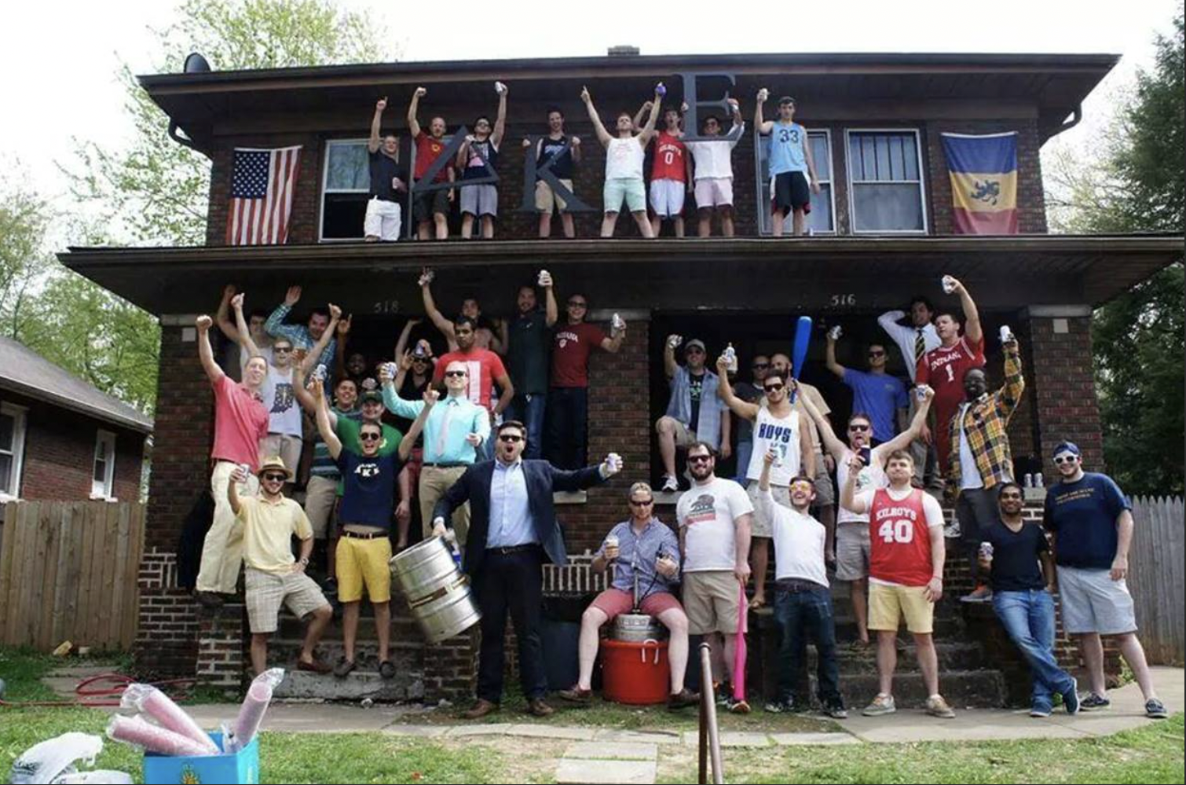
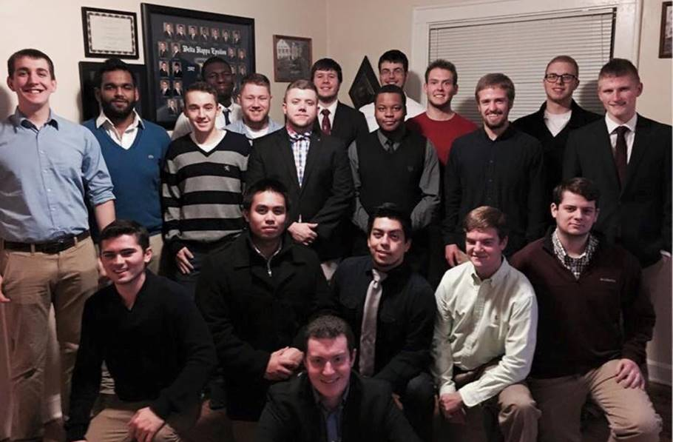
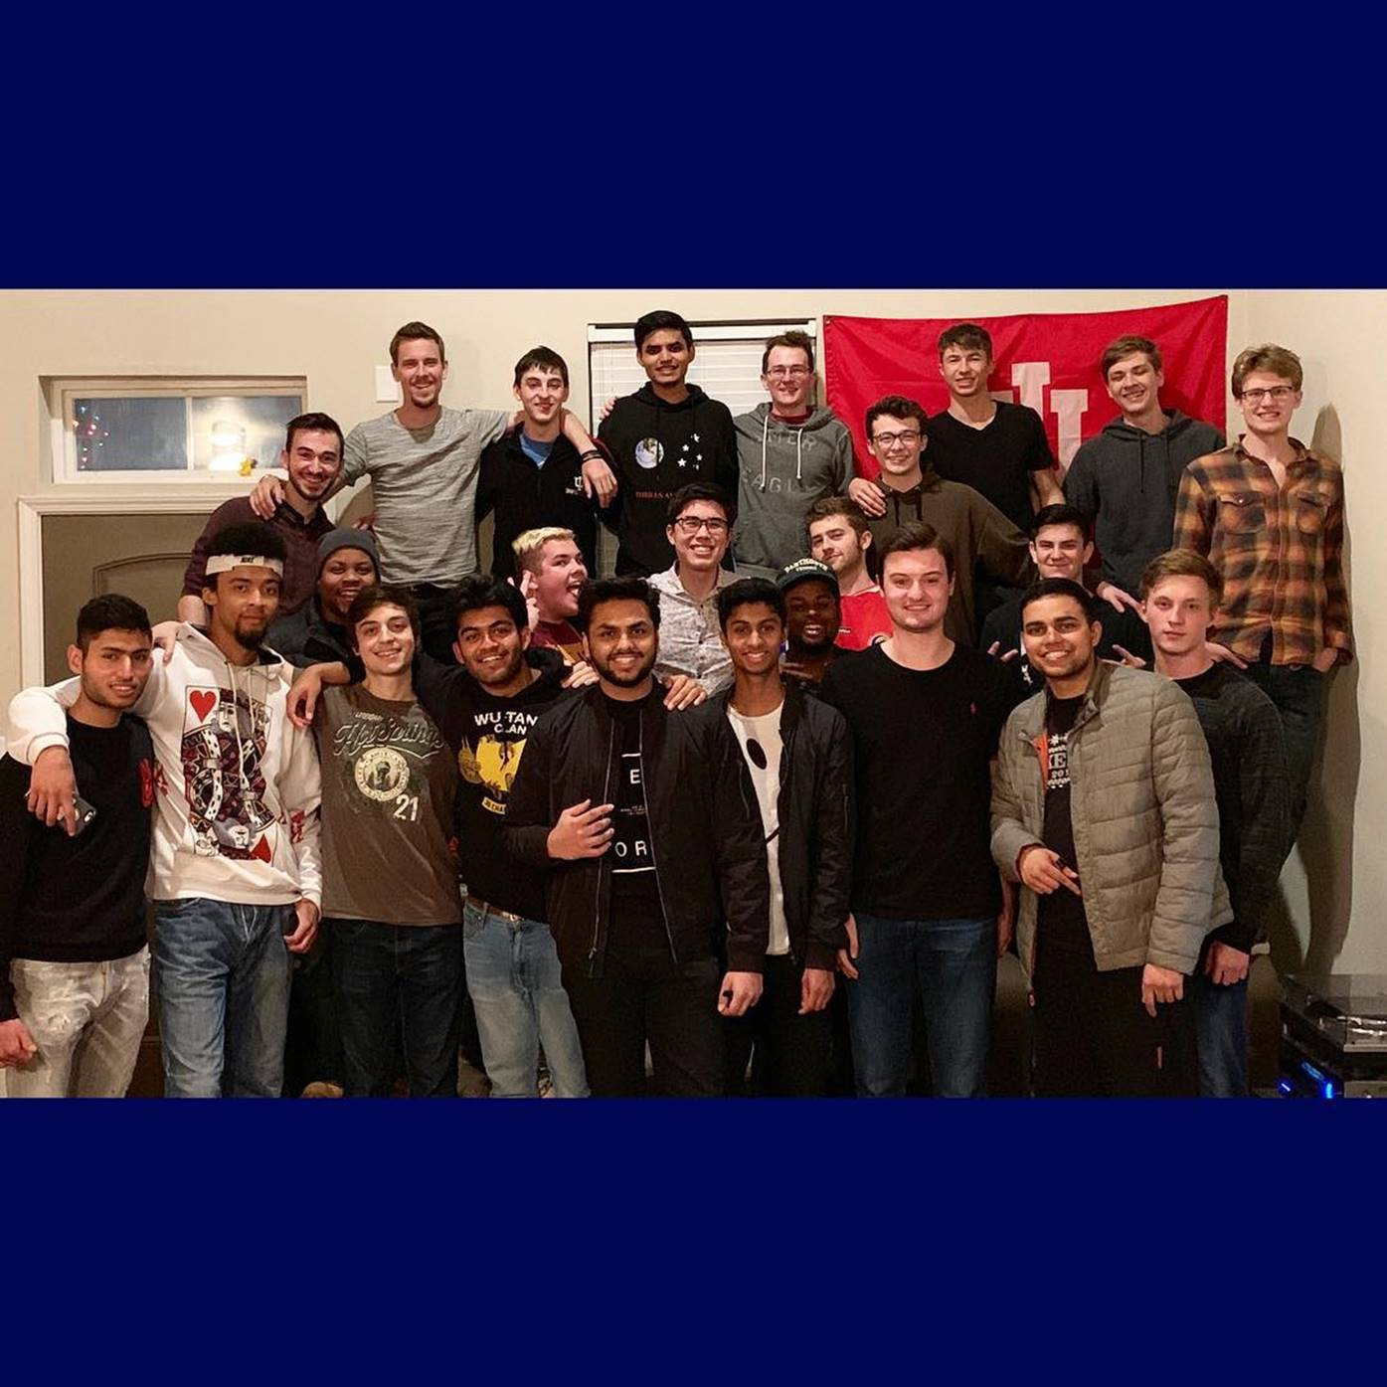
Reminiscing the Past | The Old Delta Psi
Alumni, we asked nationals to provide media of the old Delta Psi Chapter as we thought you would want to reminisce on the great memories you made together. We can only aspire to live proudly in your footsteps. Please enjoy this media exemplifying our chapters vibrant history.

Slide 21
The New Delta Psi Chapter in Action
Along with the media highlighting the history of the Delta Psi Chapter, we thought you would want to see your chapter in action! That said, please enjoy the media below, highlighting what our brothers have been doing since we formed our initial interest group in Oct-’23.
Media to be added once in OneDrive

Slide 22
DELTA KAPPA EPSILON
Delta Psi Thanks You for Your Support!
AUGUST 2023
To be updated with a final remark, and a crowded link

